Slide 1


What’s Next for hospital price transparency in 2024 and beyond

Slide 2
Agenda
Current Hospital Price Transparency Requirements
New Requirements for Display of Hospital Standard Charges and Defined Timeframes for Compliance
New Requirements to Improve Enforcement
References

Slide 3
Current Hospital Price Transparency Requirements

Slide 4
Current Hospital Price Transparency Requirements
• Beginning January 1, 2021, the Hospital Price Transparency Final Rule established requirements for hospitals to make public their standard charges in two ways:
  • As a comprehensive machine-readable file
    • Single machine-readable digital file containing five standard charges for all items and services provided by the hospital
    • File format must be .JSON, .XML, or .CSV
    • Required file naming convention (<ein>_<hospitalname>_standardcharges)
    • File must be updated annually
  • In a consumer-friendly format – Display of at least 300 “shoppable services” that a healthcare consumer can schedule in advance
    • Must contain plain-language descriptions of services and group them with ancillary services
    • Not required if hospital has a price estimator tool

Slide 5
Current Hospital Price Transparency Requirements Cont.
• Information must be posted to a publicly-available website
• Information must be displayed in a prominent manner and clearly identified with the hospital location associated with the information
• Information must be easily accessible without barriers
  • No charge for accessing information
  • No username/password required
  • No need to submit personal identifying information
  • Information within the file must be digitally searchable

Slide 6
Current Hospital Price Transparency Requirements Cont.
•CMS monitors for compliance through their own audits and through complaints received from individuals or entities
•Hospital non-compliance is addressed through CMS actions
  •Written warning notice of specific violations
  •Request for corrective action plan
  •Civil monetary penalties (CMP)
    •Maximum daily CMP of $300 for hospitals with 30 or fewer beds
    •Maximum daily CMP of $10 x number of beds for hospitals with 31-550 beds
    •Maximum daily CMP of $5,500 for hospitals with 551+ beds
  •Publication of imposed civil monetary penalties to a public website

Slide 7
New Requirements for January 1, 2024

Slide 8

New Requirements for
January 1, 2024
  Good Faith Effort
    Each hospital must make a good faith effort to ensure that the standard charge information encoded in the machine-readable file is true, accurate, and complete as of the date indicated in the machine-readable file.

Slide 9
Requirements to Improve Automated Access to the MRF - January 1, 2024
A .txt file in the root folder (base URL of the website) that includes a standardized set of fields
  Hospital location name that corresponds to the MRF
  The source page URL that hosts the MRF
  A direct link to the MRF (the MRF URL)
  Hospital point of contact information
Footer Link
  The public website must include a link in the footer on its website, including but not limited to the homepage, that is labeled “Price Transparency” and links directly to the publicly available web page that hosts the link to the MRF.

Slide 10
New Requirements for July 1, 2024

Slide 11
New Requirements for July 1, 2024
Require display of standard charge information using a CMS Template layour in .json or .csv format, data specifications, and data dictionary
  Template, data dictionary, and other technical instructions can be found at githubhttps://github.com/CMSgov/hospital-price-transparency/tree/master/documentation
CMS-defined affirmation statement in the MRF that the information displayed is true, accurate, and complete as of the date indicated in the file

Slide 12
Required Data Elements – July 1, 2024
General data elements
  Hospital name(s) – Legal business name of the hospital
  Hospital license number(s) and two-letter state code issuing the license
  Location name(s) and addresses(es) under the hospital license number
    –Location names and addresses must include all inpatient facilities and stand-alone emergency departments at minimum
  Version number of the CMS template used
  Date of the most recent update to the machine-readable file

Slide 13
Required Data Elements – July 1, 2024
Standard Charge data elements
  Gross Charge – The charge for an individual item or service that is reflected on a hospital’s chargemaster, absent any discounts
  Discounted Cash – The charge that applies to an individual who pays cash for a hospital item or service
  Standard Charge Methodology – The type of contract arrangement associated with the payer-specific negotiated charge
    –Valid values: Case Rate, Fee Schedule, Percent of Total Billed Charges, Per Diem, and Other
  Payer-Specific Negotiated Charge – Charge expressed as a dollar amount, percentage or algorithm that hospital has negotiated for an item or service
  Minimum – The lowest charge a hospital has negotiated with all 3rd-party payers for an item or service
  Maximum – The highest charge a hospital has negotiated with all 3rd-party payers for an item or service

Slide 14
Required Data Elements – July 1, 2024
Standard Charge data elements
  Payer Name – The name of the 3rd-party payer that is legally responsible for payment of a claim for a healthcare item or service
  Plan Name – May be indicated as categories (e.g., all PPO Plans) when payer-specified negotiated charges apply to each plan in the category
  Additional Generic Notes - A free text data element to help explain any of the data that aids in the comprehension of the standard charges

Slide 15
Required Data Elements – July 1, 2024
Item & Service data elements
  General Description - The description of the item or service that corresponds to the standard charge the hospital has established.
  Setting - The place where the item or service is provided for the associated standard charge amount
    –Valid Values: Inpatient, Outpatient, or Both

Slide 16
Required Data Elements – July 1, 2024
Coding data elements
  Billing/Accounting Codes - Any code used by the hospital for purposes of billing or accounting for the item or service
  Code Type – Used to clarify type of billing or accounting code
  –Current Procedural Terminology (CPT) - All Patient Severity-Adjusted DRG (APS-DRG)
  –National Drug Code (NDC) - All Patient Refined DRG (APR-DRG)
  –Revenue Code (RC) - Ambulatory Payment Classification (APC)
  –International Classification of Diseases (ICD) - Local Code Processing (LOCAL)
  –Diagnosis Related Groups (DRG) - Enhanced Ambulatory Patient Grouping (EAPG)
  –Medicare Severity DRG (MS-DRG) - Health Insurance Prospective Payment System (HIPPS)
  –Refined DRG (R-DRG) - Current Dental Terminology (CDT)
  –Severity DRG (S-DRG) - Charge Description Master (CDM)
  –TriCare DRG (TRIS-DRG)

Slide 17
Required Data Elements – July 1, 2024
Affirmation in the MRF
  CMS-defined affirmation statement in the MRF that the information displayed is true, accurate, and complete as of the date indicated in the file
    –Required Statement: To the best of its knowledge and belief, the hospital has included all applicable standard charge information in accordance with the requirements of 45 CFR 180.50, and the information encoded is true, accurate, and complete as of the date indicated.
    –Value of “True” or “False” entered by hospital

Slide 18
New Requirements for January 1, 2025

Slide 19
Required Data Elements – January 1, 2025
Estimated Allowed Amount - The average dollar amount that the hospital has historically received from a 3rd-party payer for an item or service
  Required when the standard charge methodology is percentage or algorithm
  CMS will allow hospitals flexibility in calculating this amount, but they agree that using EDI 835 data would appear to meet this requirement
  CMS recommends that the hospital encode 999999999 in the data element value to indicate that there is not sufficient historic claims history to derive the expected allowed amount, and then update the file when sufficient history is available.
  CMS Cell Suppression Policy is recommended as a guideline for establishing sufficient history
    –Requires at least 11 instances before data can be displayed

Slide 20
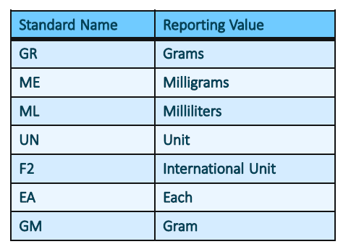
Required Data Elements –
January 1, 2025
Drug Information
  Drug Unit of measurement - The unit value that corresponds to the established standard charge for drugs
  Drug Type of Measurement - The measurement type that corresponds to the established standard charge for drugs as defined by either the National Drug Code or the National Council for Prescription Drug Programs

Slide 21
Required Data Elements – January 1, 2025
Modifier Code - Two-digit code
Modifier Description – The common name of the modifier
Modifier Payer Information – Description of how the modifier may change the standard charge for the specified payer/plan
  –For example, modifier 50 applies 150% change to the standard charge amount
  –Modifiers that impact the standard charge will be required

Slide 22
Optional Data Elements

Slide 23

Optional Data Elements
Financial Aid Policy – Information may be displayed as a description or as a link to the financial aid policy on the hospital’s website
Billing Class – The type of billing for the item or service
  Valid Values: Professional, Facility, or Both

Slide 24
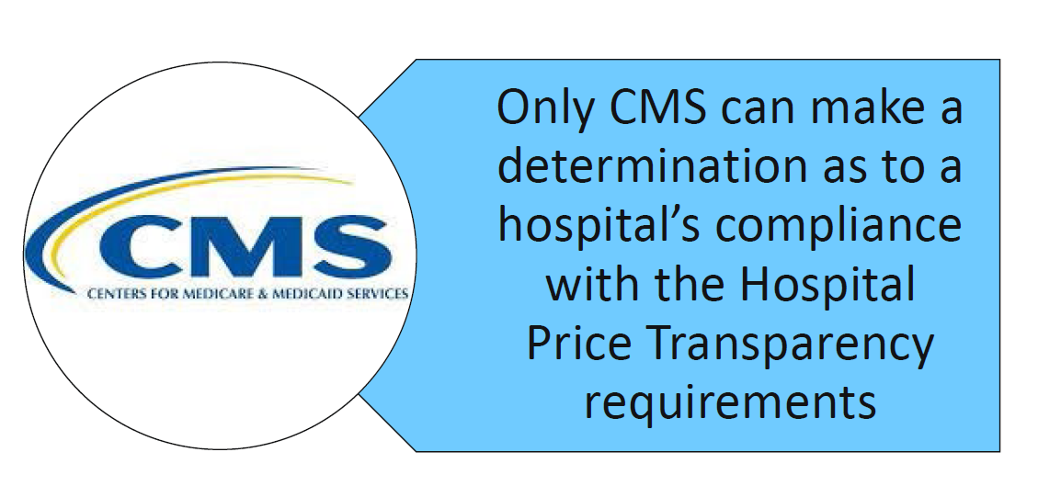

Slide 25
Monitoring and Assessment Changes
Addition of activities that may be used to monitor and assess for compliance
  CMS may conduct a comprehensive compliance review of standard charge information posted on a publicly available website
  Use of audits will be retained
Upon request, CMS may require an authorized representative of the hospital to submit a certification as to the accuracy and completeness of the standard charge information posted in the machine-readable file
Hospitals will be required to acknowledge receipt of warning notices issued by CMS by the deadline specified in the warning notice
CMS may notify health system leadership when action is taken against a hospital that is part of a larger health system

Slide 26
Monitoring and Assessment Changes
Expansion of publicized information related to hospitals’ compliance
  CMS’ assessment of a hospital’s compliance
  Any compliance action taken against the hospital
  The status or outcome of the compliance action
  Notifications sent to health system leadership

Slide 27
References

Slide 28
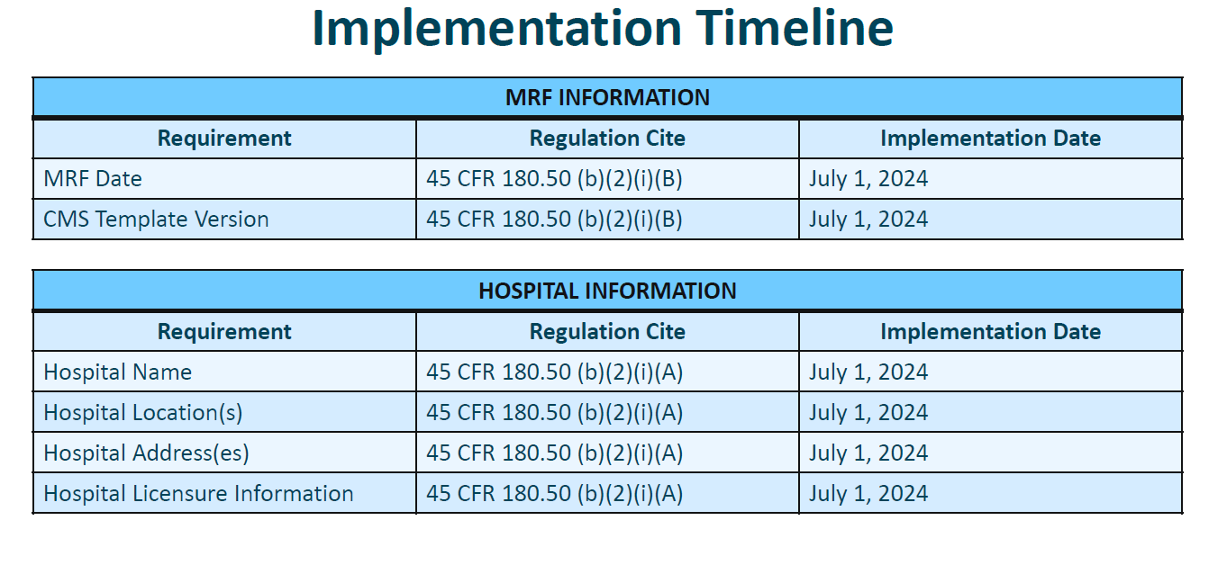

Slide 29
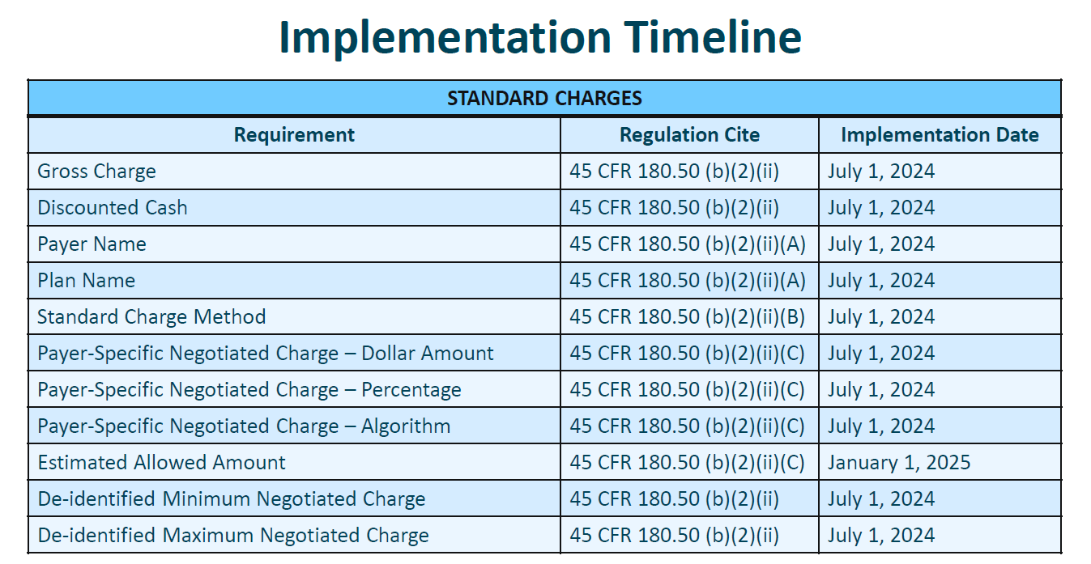

Slide 30
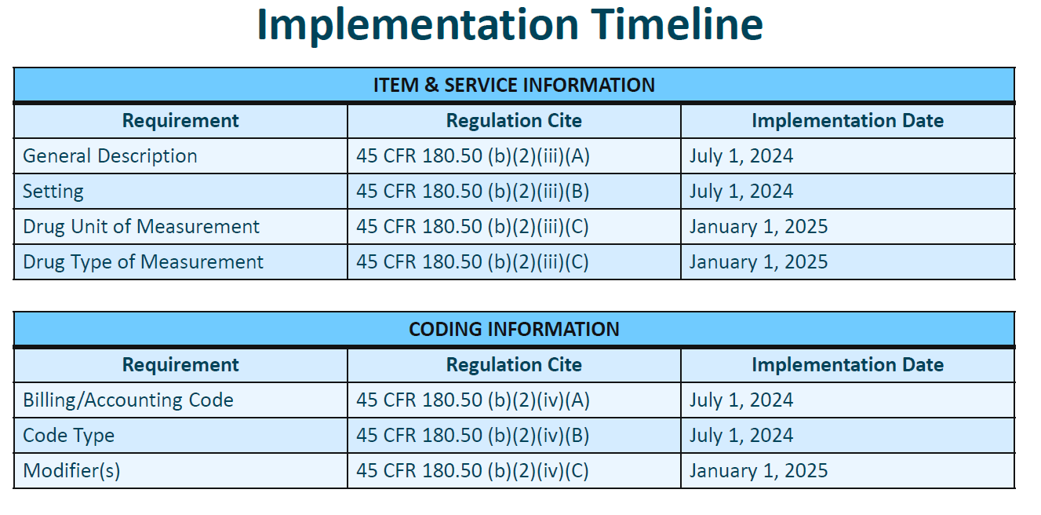

Slide 31
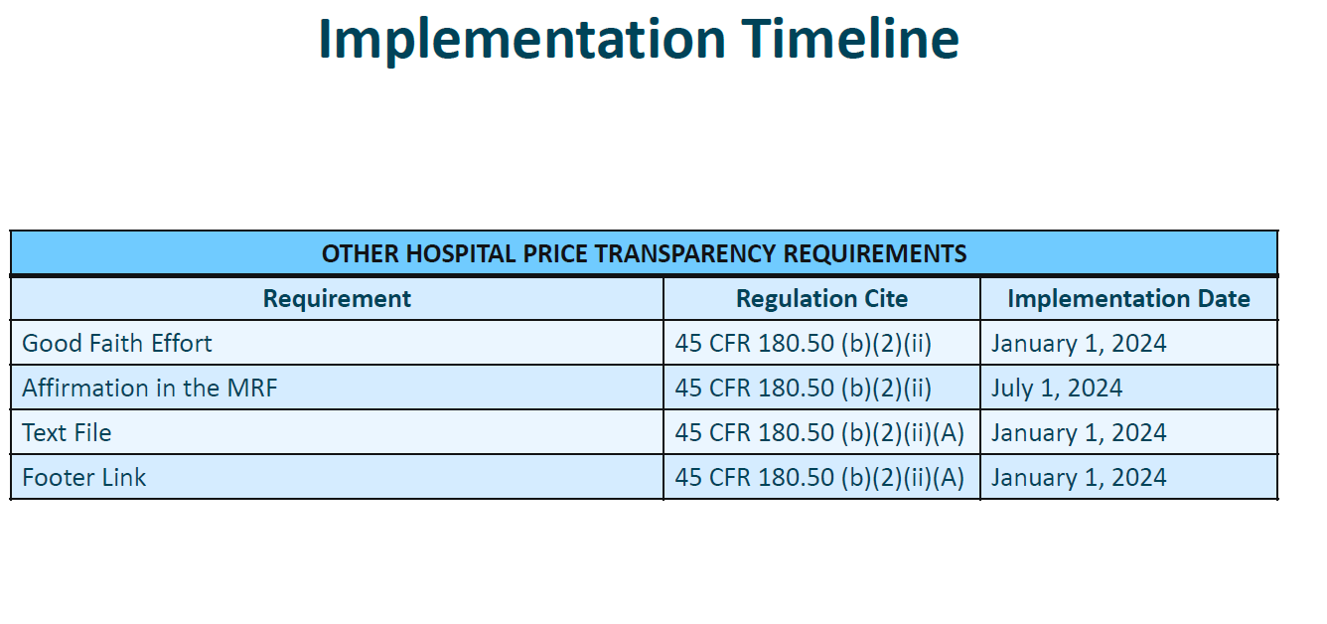

Slide 32


