Slide 1
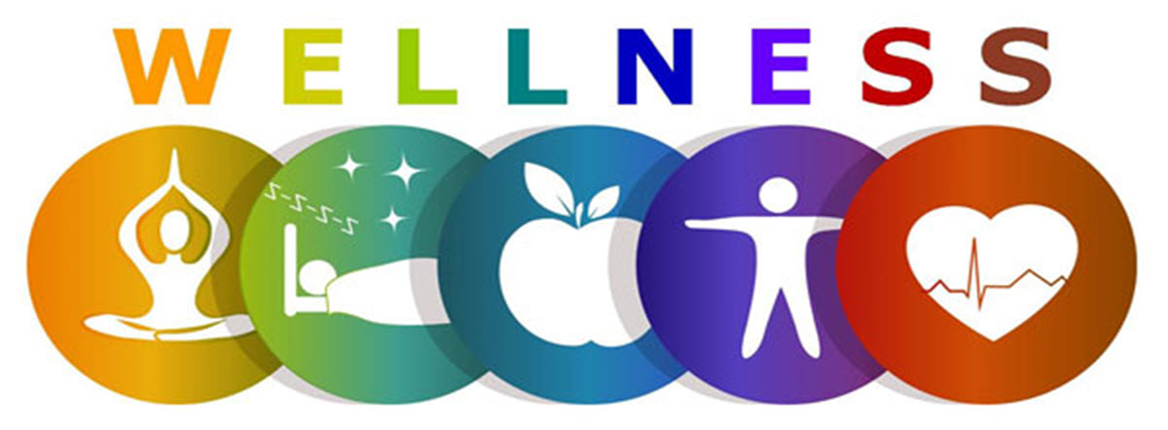
Why Wellness?

Slide 2
Why focus on hospitals?
Reduce insurance and workers’ compensation claims expense
Improve health of your team member
More positive work environment
Reduce absenteeism
SAVES lives

Slide 3
Why focus on hospitals?
Concept is compatible with mission to prevent and treat chronic disease
24/7 operations
Establishes norms in the community related to healthy behaviors

Slide 4
Why focus on hospitals?
12 billion in food and beverage purchases per year
122 community hospitals in Kansas
  More than 72,000 employees
  More than 265,400 patients discharged in 2022
  Countless others involved in outpatient, visitors, etc.

Slide 5
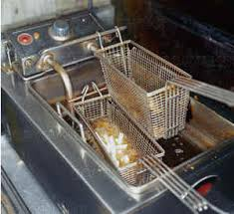
Why focus on hospitals?
Adults spend 1/3 of their day (on average) at work where they consume meals, beverages and snacks in worksite cafeterias, vending machines and at meetings.
Dietary risks are the #1 cause of preventable mortality.*
*The American Heart Association

Slide 6
Obesity and the Workplace
72 million adults are overweight or obese in the U.S.
27 percent of the rise in health care costs are associated with increases in obesity rates.
Healthy employees are:
  More productive
  Miss less work
  Fewer health care costs
  Experience fewer injuries/accidents
  Have better morale

Slide 7
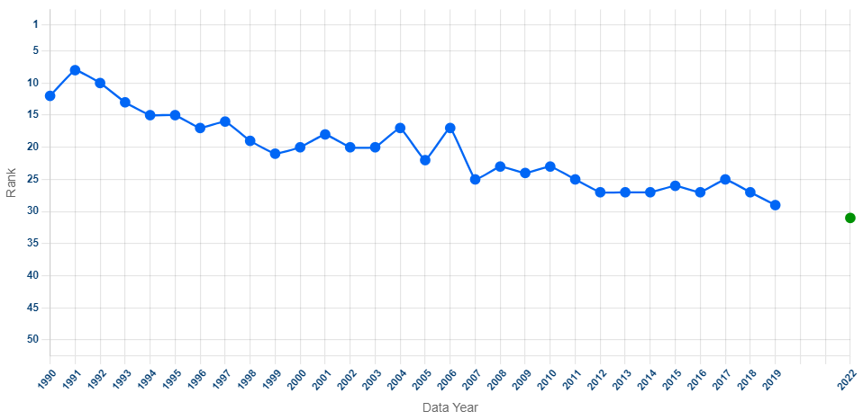
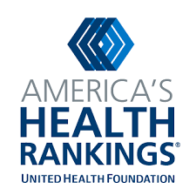
Kansas Health Rankings
KS ranks 31st in nation in overall health
KS ranked 8th in overall health in 1991
Source: America's Health Rankings. https://www.americashealthrankings.org/explore/annual/measure/Overall/state/KS
Notes:
Here is another section that I thought you might find of interest on why they didn’t do the overall rankings the last 2 years; and we can speak to why there are blanks for 2020 – 2021 in the trend graph.
Reintroducing overall state rankings in 2022
This year’s report re-introduces state rankings, which were excluded over the past two years due to the extraordinary and unprecedented health challenges faced by states during the pandemic. Built on the World Health Organization definition of health — “Health is a state of complete physical, mental and social well-being and not merely the absence of disease or infirmity” — the America’s Health Rankings model ranks states across a variety of categories encompassing health and its determinants, including social and economic factors, physical environment, behaviors, clinical care and health outcomes. In doing so, it aims to equip state leaders with benchmarks that can inform action as they seek to improve the health of their communities and address both new challenges introduced by the pandemic and longstanding disparities that may have been exacerbated by the pandemic. New Hampshire was the healthiest state, followed by Massachusetts (No. 2), Vermont (No. 3), and Connecticut and Hawaii (tied at No. 4). Louisiana had the most opportunity to improve, followed by Mississippi (No. 49), Arkansas (No. 48), West Virginia (No. 47) and Alabama (No. 46).

Slide 8
Source: Kansas Behavioral Risk Factor Surveillance System

Slide 9
Employers Can Make a Difference
Healthy eating is crucial in the prevention and management of overweight and obesity.
Employers can implement policy, systems and environmental initiatives that make healthy food more affordable, accessible and appealing.

Slide 10

Where to Start?

Slide 11

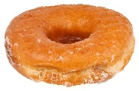
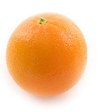
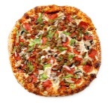
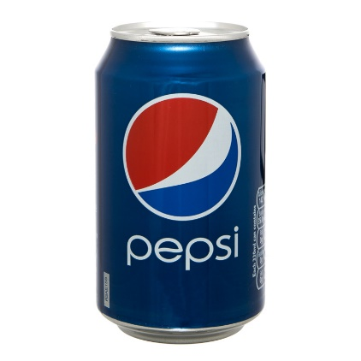
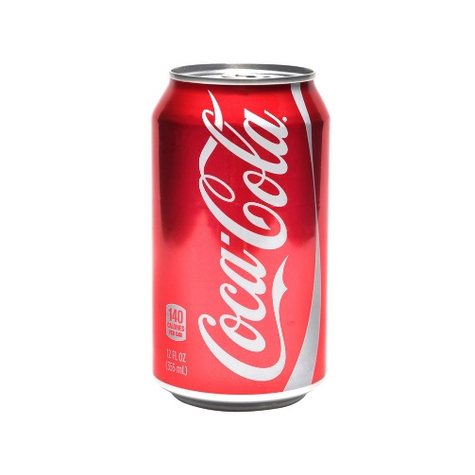
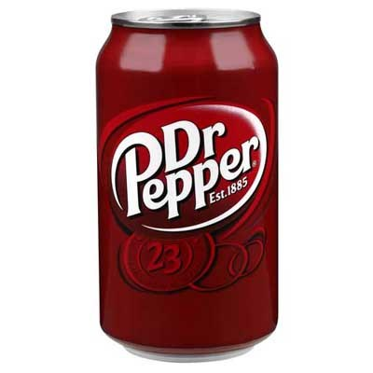
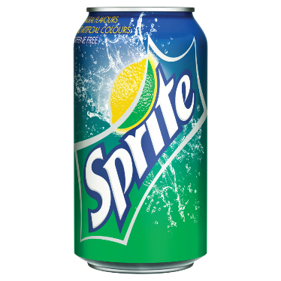
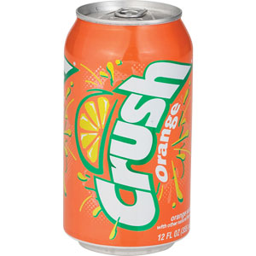
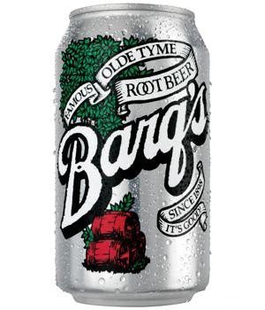
F d f r
Th ught?
Sugar-Sweetened Beverages
Notes:
I want to share with you one area that Healthy Kansas Hospitals is really trying to focus on. Sugar-Sweetened Beverages.

Slide 12
Sugar-sweetened beverages
Sugar-sweetened beverages contain added caloric sweeteners, such as:
  Sweetened tea
  Sports drinks (beverages marked for rehydration for athletes)
  Fruit drinks, fruit juices and fruit nectars with added sugar.
  Sodas include all carbonated beverages with added sugar.
  Lemonade / Fruit Punch
  Flavored Milk
  Energy drinks
Notes:
Sugar-sweetened beverages (SSBs) contain added caloric sweeteners, such as:
sweetened tea
Sports drinks (beverages marked for rehydration for athletes)
Fruit drinks, fruit juices and fruit nectars with added sugar.
Sodas include all carbonated beverages with added sugar.
Lemonade / Fruit Punch
Flavored Milk
Energy drinks

Slide 13
Sugar-sweetened beverages
Play a significant role in current obesity trends.
10% of daily calories consumed by Americans in the US Diet.
63% of adults and 80% of youth consume at least 1 sugar-sweetened beverage daily.
The per-capita average consumption of carbonated soft drinks alone is 46 gallons per year per person (Not even including other sugar-sweetened beverages).
Such beverages are no longer considered a treat, but a regular contributor of daily calories and not in moderation.
Notes:
Sugar-Sweetened Beverages play a significant role in current obesity trends. Such beverages are no longer considered a treat, but a regular contributor of daily calories and not in moderation. What do you think about this? Do you agree with this statement? – Give time for feedback.
10% of daily calories consumed by Americans in the US Diet
63% of adults & 80% of youth consume at least 1 sugar-sweetened beverages each day.
The per-capita average consumption of carbonated soft drinks alone is 46 gallons per year per person (Not even including other sugar-sweetened beverages') That is a a lot.

Slide 14
Sugar-sweetened beverages
Drinking one 12 oz. sugary drink a day can increase the risk of diabetes by 22% (Romaguera, Diabetologia, Apr 2013).
About 14% of Kansas adults have diabetes (180,000 diagnosed, 120,000 undiagnosed) (KS Diabetes Council).
Result of diagnosed diabetes is an additional annual average medical expenditure of about $7,900 (American Diabetes Association).
Notes:
As it relates to diabetes:
Drinking one 12 oz. sugary drink a day can increase the risk of diabetes by 22% (Romaguera, Diabetologia, Apr 2013).
About 14% of Kansas adults have diabetes (180,000 diagnosed, 120,000 undiagnosed) (KS Diabetes Council)
Result of diagnosed diabetes is an additional annual average medical expenditure of about $7,900 (American Diabetes Association).

Slide 15
Health risks of sugary drinks
Weight gain/obesity
Diabetes
Hypertension
Negative impact on cardiovascular health
Poorer oral health
Can you think of other health risk?
Notes:
Some of the health risks associated with sugary drinks are:
Weight gain/obesity
Diabetes
Hypertension
Negative impact on cardiovascular health
Poorer oral health
Can you think of others? Give time to answer.

Slide 16
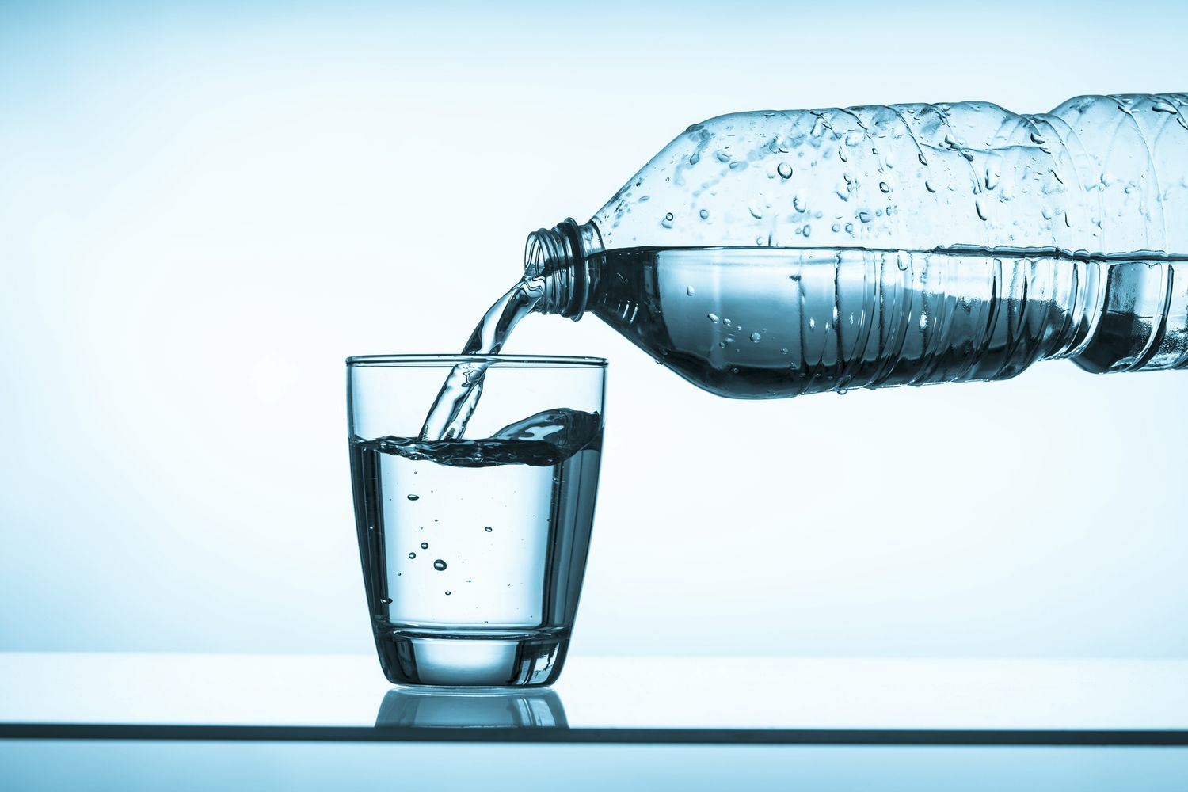
What are the benefits of water?
Notes:
We have talked about Sugar-sweetened beverages and the negatives, lets talk about the flipside. What are the benefits to water? Give time to answer.

Slide 17
http://www.cspinet.org/nutritionpolicy/healthy-vending.html
Notes:
Here is a side by side comparison of the cons of soda, and the benefits of water. Tooth decay, a lot of sugar, high blood pressure, cancer, 200 calories, diabetes, liver damage, bone loss, stroke, the list goes on and on. The benefits of water, 0 calories, hydrating, vital for life, refreshing, natural, no preservatives. Again, I am not saying don’t have a pop every now and then but lets go back to making it a treat, not a regular contributor of daily calories.

Slide 18
http://cspinet.org/new/pdf/25lbs_poster.pdf
Notes:
25 pounds. That’s the amount of weight you could gain in one year simply by drinking one 20 oz. soda instead of an unsweetened beverage each day. Is it worth it?

Slide 19
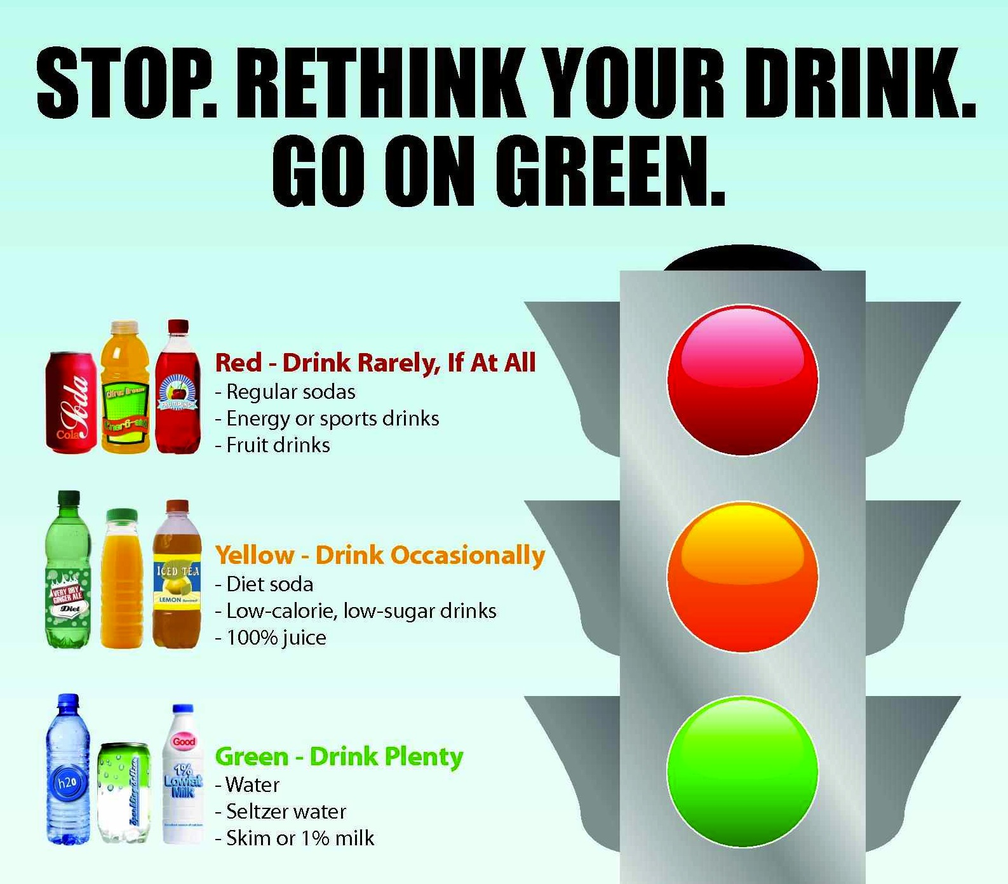
Notes:
Here is a resource that is in our first toolkit to help give a visual of how Sugar-Sweetened Beverages should be consumed. With the stoplight, red being drink rarely, if at all. Yellow, drink occasionally and green, drink plenty. Its not to police people but to make you stop and think about what you are putting in your body.

Slide 20
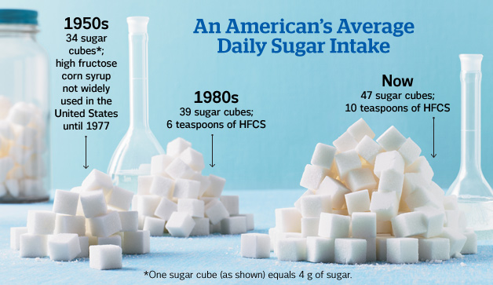
http://www.prevention.com/food/healthy-eating-tips/real-ways-eat-less-sugar
Notes:
When thinking about how we got here and our intake of sugar. This image really helped see how we have developed and why we as humans drink so many Sugar-Sweetened Beverages. According to the American Heart Association (AHA), the maximum amount of added sugars you should eat in a day are: Men: 150 calories per day (37.5 grams or 9 teaspoons). Women: 100 calories per day (25 grams or 6 teaspoons). So what can we do to reduce our sugar intake along with other things?

Slide 21
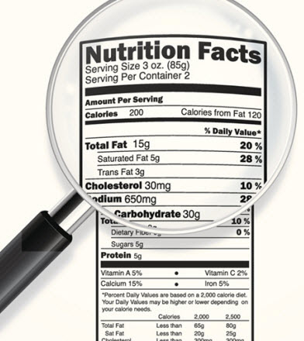
Healthy Beverage Examples
Filtered tap water is the optimal beverage
100% Fruit juice (optimal 4oz serving)
100% Vegetable juice (optimal sodium less than 140 mg)
Milk (unflavored AND Certified Organic or rBGH-free)
Non-dairy milk alternatives (unsweetened)
Teas and Coffee (unsweetened)
Read YOUR Food Labels!
Notes:
What are things we can do to change our drinking habits? Read the labels on the back of food and beverages. This is key, in making changes for yourself. Something you might think are healthy drinks for you could contain a lot of hidden sugar.
Examples of heathy beverages:
Filtered tap water is the optimal beverage
100% Fruit juice (optimal 4oz serving)
100% Vegetable juice (optimal sodium less than 140 mg)
Milk (unflavored AND Certified Organic or rBGH-free)
Non-dairy milk alternatives (unsweetened)
Teas and Coffee (unsweetened)

Slide 22
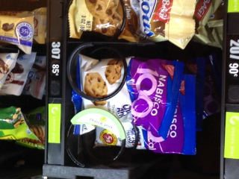
Vending Machines
Processed food options are typically high in fat, salt and sugar, while fresh food is scarce. The beverages also are high in sugar and fat.
Frequently used in hospitals by staff and visitors after cafeteria closures (generally after 7 p.m.)
Placement of healthier foods in vending machines (upper right)
or identification of the healthier selections with stickers can
make them more visible and increase purchase/consumption.
Include low-fat granola bars, reduced-fat cookies or crackers,
whole grain cereal bars, baked chips or pretzels.

Slide 23
Where to go from here?
Form a worksite wellness committee
Checkout Healthy Kansas Hospital Toolkits #1, #2, #3
Explore additional employee education
Look at current policies and practices
Questions
Insert Hospital Contact Name
Email
phone
Hayley Finch-Genschorck
hfinch@kha-net.org
(785) 233-7436

